Slide 1

Capstone Design (2)
13th week : Life Sports Total Solution
Date | 2019.05.27
Presenter | 이동현
Team | 공찬형, 금강현, 이동현

Slide 2
Index
Project Concept
Implementation
Schedule
Q & A

Slide 3
Project Concept

Slide 4
1. Project Concept
Just focus on the game itself.
Making a regular reservation and participating the Open Matching by using app
Team management
Recommendation System
Play the game like ‘a Game.’
Ranking System
Badge Achievement System

Slide 5
Implementation

Slide 6
2. Implementation : UI Design
Screen flow chart
: Developed
: Undeveloped
HeaderInfo
Login
Register
Register2
Mypage
JoinedTeam
TeamInfo
MainIndividual
ReservationStatus
MatchingStatus
SelectType
SelectSports
SelectRegion
FavoriteGymList
SelectPlan
ReservationCheck
JoinPlayerList
JoinPlayerDetail

Slide 7
2. Implementation : UI Design
Separate the team profile page and team recommendation page
Use ‘React-native-keychain’ library to implement auto-login
User doesn’t need to re-login if the user did login once
Save the ID and Password in inner storage (No security issue)
MainMyTeam
TeamInfo
TeamGameResult
TeamMemberList
TeamMemberDetail
MainTeam
Recommend

Slide 8
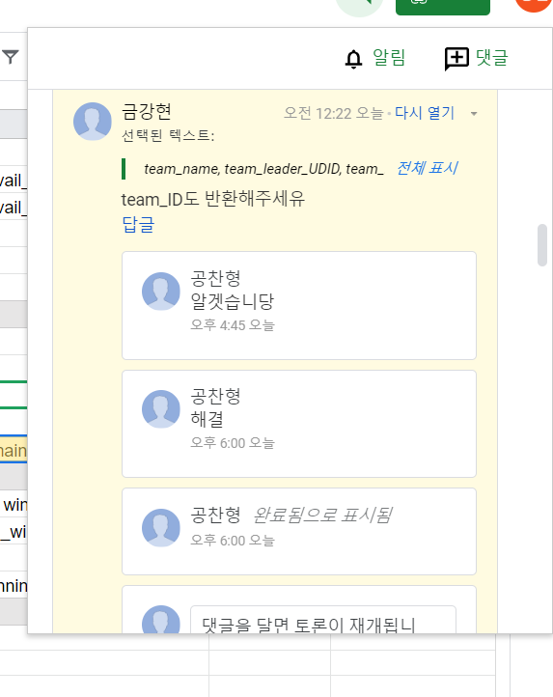
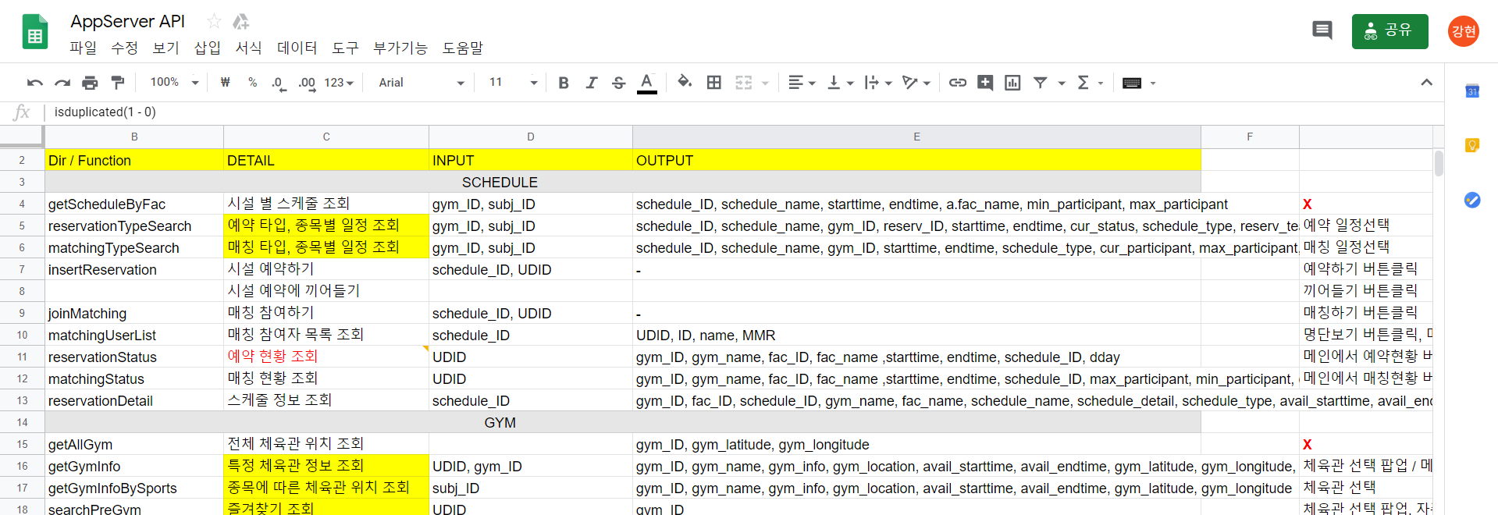
2. Implementation : UI Design
React use the same structure as ajax did for data transfer
Use Google docs as request form for communication between server and application
14 pages are able to communicate completely between server and app
8

Slide 9
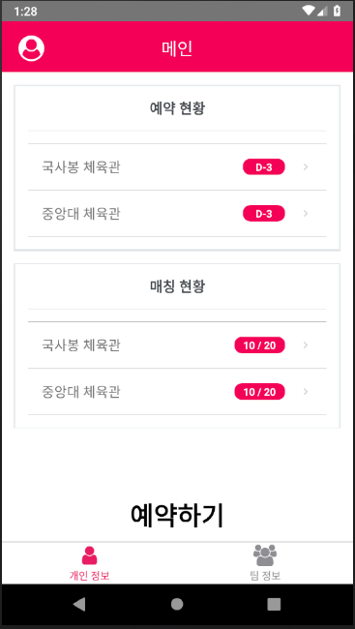
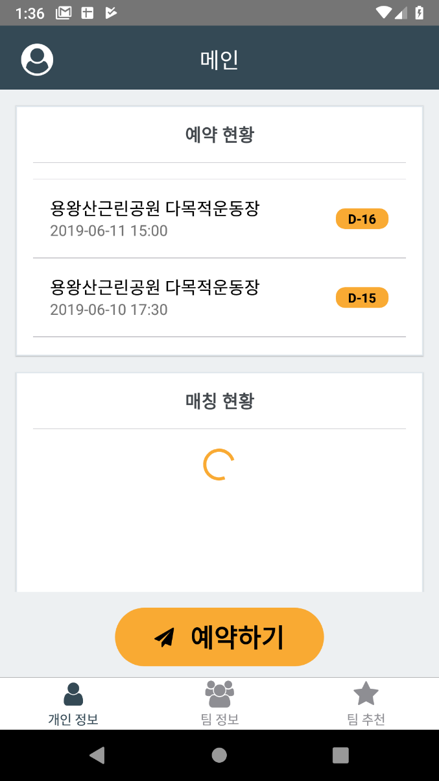
2. Implementation : UI Design
Huge updates on UI Design
Colors and Buttons are changed
New tab has been created for team recommendation
Loading screen added
Because of the low performance of web server, user needs to wait a lot
Splash screen is going to be added

Slide 10
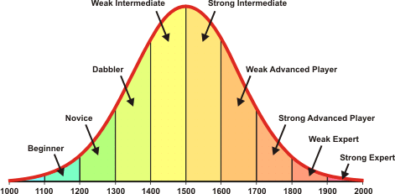
2. Implementation : MMR System
Modeled after the ELO Rating System used in Chess
MMR for whole users follow the Gaussian Distribution
Balance the winning rate to be 50% for all users
Plenty of games must be preceded for exact scoring system
MMR Distribution for Soccer records and Team MMR
MMR for user is stored in each subject record table
MMR for team is stored in team table
MVP points and winning rates are highly related to MMR
Tables Columns | Team | Soccer_record
MMR | 815 ~ 3087 | 540 ~ 3719
Winning_rates | 43% ~ 64% | -
MVP Points | - | 20~533

Slide 11







2. Implementation : MMR System
MMR Distribution
MMR Rating is approximately between 500 to 3800
Ranking System : 7 ranks exist
MMR Calculation Formula
When you win : MMR += K * (1 – winning_rate)
When you lose : MMR += K * (0 – winning_rate)
K is a constant that highly related to MMR score change
K is changed if the teams or users game were in different rank
RANK | K(Lose) | K(Win)
Stone | 12 | 30
Bronze | 15 | 27
Silver | 18 | 24
Gold | 21 | 21
Emerald | 24 | 18
Ruby | 27 | 15
Diamond | 30 | 12
0
1300
1800
2200
2600
3000
3400

Slide 12







2. Implementation : Achievements
Achievements of the user / team collected will be showed on user / team profile page
Goals of Achievements
Motivate users to play more games on various circumstances
Provide additional data for users to determine the opponents skill / level
Achievements for Users
Total number of matches the user played
The winning rate of the last ten games
MVP Points
Achievements for Teams
Total number of matches the team played
The winning rate of the last ten games
Team members count
Notes:
Spring Base Structure Developed
Servlet configure : RequestMapping을 위한 기본 설정
Maven configure : 배포 및 외부 라이브러리 사용을 위한 Maven Pom.xml 설정
Interceptor Implementation : 로그인 세션 유지 및 페이지 권한 설정을 위한 Pre-Post Interceptor 구현
Controller Implementation : Dispatch된 Request를 분기하여 처리하기 위한 Method를 선언 및 구현.
Business Logic Implementation(Service Layer) : Controller가 이용할 서비스 모듈 (데이터베이스로 자료를 읽거나, 해당 자료를 통한 연산 등) 구현
Database Connection(Mybatis – MySql) : 데이터베이스 쿼리 처리를 위한 Mybatis 설정. 기초 쿼리 구현 및 데이터베이스 접근을 위한 DAO객체 구현.
View Resolver (JSP, JSTL) : Spring MVC에 따른 View 구현. JSP, JSTL를 이용하여 페이지 개발.

Slide 13
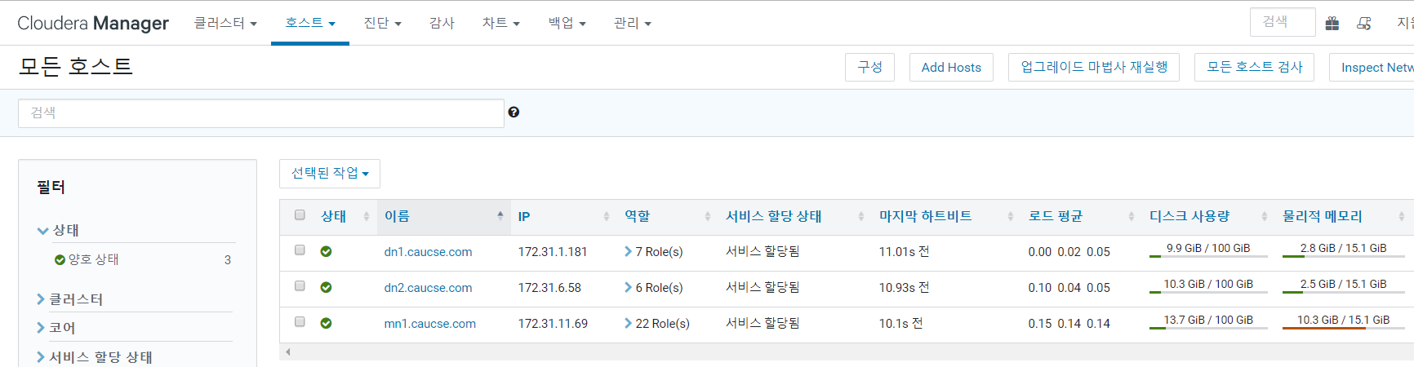
2. Implementation : Data Handling
Table Schema changed to deal with current participant and fix a few bugs
Team leader is not in the team / Team member counts exeed max count
Fac_schedule and reserve_matches ID is not matched correctly
Re-construct the Cluster with 3 nodes using AWS EC2
Cannot use the aws account we’ve used anymore
Fail to fix the issue about using Sqoop on Hue
Fail to launch Oozie launcher because of the JDBC Connector
Notes:
Spring Base Structure Developed
Servlet configure : RequestMapping을 위한 기본 설정
Maven configure : 배포 및 외부 라이브러리 사용을 위한 Maven Pom.xml 설정
Interceptor Implementation : 로그인 세션 유지 및 페이지 권한 설정을 위한 Pre-Post Interceptor 구현
Controller Implementation : Dispatch된 Request를 분기하여 처리하기 위한 Method를 선언 및 구현.
Business Logic Implementation(Service Layer) : Controller가 이용할 서비스 모듈 (데이터베이스로 자료를 읽거나, 해당 자료를 통한 연산 등) 구현
Database Connection(Mybatis – MySql) : 데이터베이스 쿼리 처리를 위한 Mybatis 설정. 기초 쿼리 구현 및 데이터베이스 접근을 위한 DAO객체 구현.
View Resolver (JSP, JSTL) : Spring MVC에 따른 View 구현. JSP, JSTL를 이용하여 페이지 개발.

Slide 14
Schedule

Slide 15
3. Personal Project Schedule
Lee, Donghyun : DB Construction & Data Analysis, Recommendation Implementation
Dates | March |  |  |  | April |  |  |  |  | May |  |  |  | June
Task Descriptions | 4 | 11 | 18 | 25 | 1 | 8 | 15 | 22 | 29 | 6 | 13 | 20 | 27 | 3 | 10 | 17
Team Organization |  |  |  |  |  |  | Midterm Demonstration & Presentation |  |  |  |  |  |  | Final Demonstration & Presentation
Subject Confirmation / Write out the Proposal
Data collection & Generation / Data modeling
Database Construction
Hadoop Installation / CDH Cluster Construction
Data Analysis using Hadoop Cluster
Test and Debugging
Preparing for Final Demo
Writing Manuals and Reports

Slide 16
3. Personal Project Schedule
Gong, Chanhyung : Web Structure construction, Web & app implementation
Dates | March |  |  |  | April |  |  |  |  | May |  |  |  | June
Task Descriptions | 4 | 11 | 18 | 25 | 1 | 8 | 15 | 22 | 29 | 6 | 13 | 20 | 27 | 3 | 10 | 17
Team Organization |  |  |  |  |  |  | Midterm Demonstration & Presentation |  |  |  |  |  |  | Final Demonstration & Presentation
Subject Confirmation / Write out the Proposal
Web UI Design
Web Structure Construction
Functional Implementation : Manager Web Site
Functional Implementation : Matching Service (App)
Functional Implementation : Ranking System (App)
Functional Implementation : Basic System (App)
Test and Debugging
Preparing for Final Demo
Writing Manuals and Reports

Slide 17
3. Personal Project Schedule
Geum, Kanghyeon : App Structure construction, Web & App implementation
Dates | March |  |  |  | April |  |  |  |  | May |  |  |  | June
Task Descriptions | 4 | 11 | 18 | 25 | 1 | 8 | 15 | 22 | 29 | 6 | 13 | 20 | 27 | 3 | 10 | 17
Team Organization |  |  |  |  |  |  | Midterm Demonstration & Presentation |  |  |  |  |  |  | Final Demonstration & Presentation
Subject Confirmation / Write out the Proposal
App UI Design
App Structure Construction
Functional Implementation : Manager Web Site
Functional Implementation : Reservation (App)
Functional Implementation : Matching Service (App)
Functional Implementation : Ranking System (App)
Functional Implementation : Basic System (App)
Test and Debugging
Preparing for Final Demo
Writing Manuals and Reports

Slide 18
3. Project Schedule
Dates Task Descriptions | March |  |  |  | April |  |  |  |  | May |  |  |  | June
 | 4 | 11 | 18 | 25 | 1 | 8 | 15 | 22 | 29 | 6 | 13 | 20 | 27 | 3 | 10 | 17
Team Organization |  |  |  |  |  |  | Midterm Demonstration & Presentation |  |  |  |  |  |  | Final Demonstration & Presentation
Subject Confirmation / Write out the Proposal
Web UI Design
Web Structure Construction
Data collection & Generation / Data modeling
Database Construction
App UI Design
App Structure Construction
Functional Implementation : Manager Web Site
Functional Implementation : Reservation (App)
Hadoop Installation / CDH Cluster Construction
Data Analysis using Hadoop Cluster
Functional Implementation : Matching Service (App)
Functional Implementation : Ranking System (App)
Functional Implementation : Basic System (App)
Test and Debugging
Preparing for Final Demo
Writing Manuals and Reports

Slide 19
Q&A

